Slide 1


Leadership & Personality development

Slide 2

Leadership
Definition:
Leadership is the ability of an individual or a group of individuals to influence and
guide followers or other members of an organization.
According to Peter Drucker, “ Leadership is
shifting of own vision to higher sights, the raising of
man’s performance to higher standards, the building of
man’s personality beyond its normal limitations.”

Slide 3
Types of leadership
AUTOCRATIC LEADERSHIP STYLE:
In this leadership style all policies and procedures are determined by the leader.
2. DEMOCRATIC LEADERSHIP STYLE:
In this leadership style policies are matter of a group decision and discussion with active encouragement and assistance by the leader.
LAISSEZ FAIRE LEADERSHIP STYLE:
In this leadership style, leader a plays a rather passive role in social participation and leaves complete freedom for group are individual decisions in relating to group activity and procedure.

Slide 4
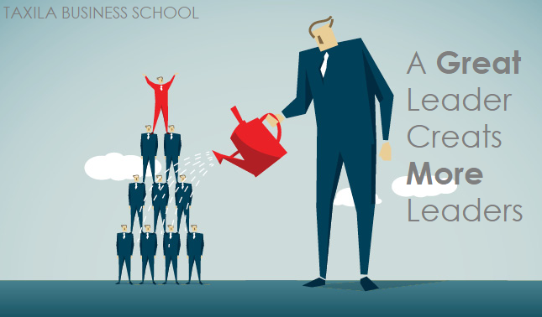
Who is Leader?
A leader is someone who can see how things can be improved and who rallies people to move toward that better vision. Leaders can work toward making their vision a reality while putting people first. Just being able to motivate people isn’t enough - leaders need to be empathetic and connect with people to be successful.

Slide 5

Traits of a Leader:
Alertness
Bearing
Courage
Decisiveness
Dependability
Endurance
Enthusiasm
Initiative
Integrity
Judgment
Justice
Knowledge
Loyalty
Sense of Humour
Unselfishness

Slide 6
ALERTNESS:
Alertness of a mind is what helps a leader to pip-up the opportunities at the right time and exploit the situation to his/her own advantage.
BEARING:
A leader and more so an officer should, therefore remember that his personal bearing will exercise a dominating and permeating influence not only with his own team but with the general public too.
COURAGE:
It’s a mental quality that enables an man to accept responsibility and act correctly in a threatening situation with calmness and firmness requires moral and physical courage.

Slide 7
DECISIVENESS:
It is the ability to take decision promptly and announce them in a clear and forceful manner.
DEPENDABILITY:
It’s proper performance of duty and carrying out actively, intelligently and willingly the orders of superior.
ENDURANCE:
It’s a mental and physical stamina measured by the ability to with stand pain, fatigue, stress and hardships.
ENTHUSIASM:
It’s the display of sincere interest and zeal in performance of duties.

Slide 8
INITIATIVE:
It’s to do what is to be done even in the absence of orders and to avoid inactivity.
INTEGRITY:
It’s a uprightness of the character, soundness of moral principles, quality of absolute truthfulness and honesty.
JUDGMENT:
It’s the quality of logically weighing facts on which to make sound decision.
JUSTICE:
It’s the quality of being impartial and consistent.
KNOWLEDGE:
A leader must have sound knowledge than the man he commands.

Slide 9
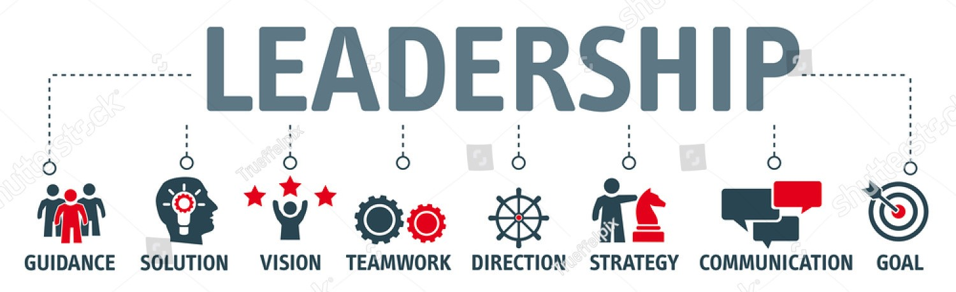
LOYALTY:
It’s the quality of faithfulness to country, one’s seniors and colleagues.
SENSE OF HUMOUR:
It’s the ability to remain cheerful under stress.
UNSELFFISHNESS:
It’s the quality of refraining from own comfort and personal advancement at the expense of others.

Slide 10

Personality development
DEFINITION:
Personality Development means enhancing and grooming one’s outer and inner self to bring about a positive change to your life which includes boosting one’s confidence, improving communication and language speaking abilities, widening one’s scope of knowledge, developing certain hobbies or skills, learning fine etiquettes and manners, adding style and grace to the way one looks, talks and walks and overall imbibing oneself with positivity, liveliness and peace.

Slide 11
HOW TO DEVELOP THE PERSONALITY
Judgement:
Understand the situation from at this point of view, setting aside personal interest and opinion helps in taking appropriate decision that benefits all.
Mirroring:
Understand the body language of ideal people and make it as part of your attitude.
Be Cheerful and Nice:
Always make sincere efforts to raise others spirits.
Be Sincere and Trustworthy:
Make others feel that whenever they need your help you will always be there to help.
Provide Compelling Ideas:
Justify how your ideas and suggestions could be the most effective techniques to implement.

Slide 12
Conviction:
This is a very important thing while persuading anyone. People are self-centered and they always put their own ideas and well-being before others. Your own conviction in convincing others is essential.
Positive Attitude:
This leads to the confidence of the individuals. So whatever the situation may be, one should always try to be positive in thinking and attitude.
Leadership Skills:
Leadership is the quality of influencing the activities of an individual or a group towards the achievement of a goal in a given situation.
Communication Skills:
An effective communication skill is necessary to achieve success. A good communication skill is essential to influence others.

Slide 13
ROLE OF NCC IN PERSONALITY DEVELOPMENT
DRILL:
Active participation in drill helps cadets keep correct posture. They will walk more confidently than others. A good physique is an integral part of a good personality.
INTERACTION OF CADETS IN CAMPS:
An NCC cadet gets many good opportunities to interact with cadets from different parts of the country. Camps groom their personality. Here cadets from different states exchange information of each other’s culture and traditions. Thus they learn about the diverse culture of the nation. They become friends resulting in the development of comradeship and personality.

Slide 14
COMPETITIONS:
Various competitions in camps, drill and performing cultural programs, develop sports man ship and team sprit among the cadets.
SPORTS AND ADVENTURE ACTIVITIES:
Sports and adventure are important for youth has they teach them a number of useful lessons on comradeship, healthy competition, courage to face challenges, art of leadership, teamwork, grit and determination.

Slide 15

Self motivation:
Self-motivation is a skill that enables you to do things. It is a key life skill, simply a force that drives you to accomplish tasks and goals.
If you are interested in personal development, you should consider about this skill seriously.

Slide 16
Self confidence:
Not only about tasks or world you have to think positive about yourself. You need to have a trust in yourself and your abilities.
When you start along path to develop a healthy personality, must keep in mind that there will be setbacks and failures along the way.
SURROUND YOURSELF WITH GOOD COMPANY:
‘A man is known by the company he keeps’ is a very common quote. Very few people really understand the meaning and power of this short sentence. Surround yourself with motivators.

Slide 17
LEARN FROM MISTAKES:
When you keep focusing on your previous mistakes, you are killing your motivation.
Learning from your mistakes can help motivate you since you know what to avoid.
Today is a new day. Motivate yourself, so you can achieve what you want and deserve.
START SMALL:
To get to where you want to be requires serious effort. You need to start taking small steps, so you can get to where you want to be.
Once started, it will become easy for you to continue moving forward.

Slide 18

CHARACTER TRAITS
Speak Truth
Be Honest
Keep your word
Own up your mistake
Be your own judge
Do not seek cheap popularity
Resist temptations

Slide 19

Set an example
Sense of responsibility
Self sacrifice
Be impartial
Discipline
Do your duty

Slide 20

THANK YOU
JAI HIND

